Slide 1
Dropout Regularization in Deep Learning
By Aymen Tariq

Slide 2
What are Regularization Techiques?
The problem of overfitting and underfitting can occur in machine learning
Underfitting is that situation where the model can predict accurate values but initially, the assumption about the data is incorrect.
Overfitting is when your model is very complex for your data and it cannot do accurate predictions
The techniques used to tackle the issue of overfitting and underfitting are called regularization techniques

Slide 3
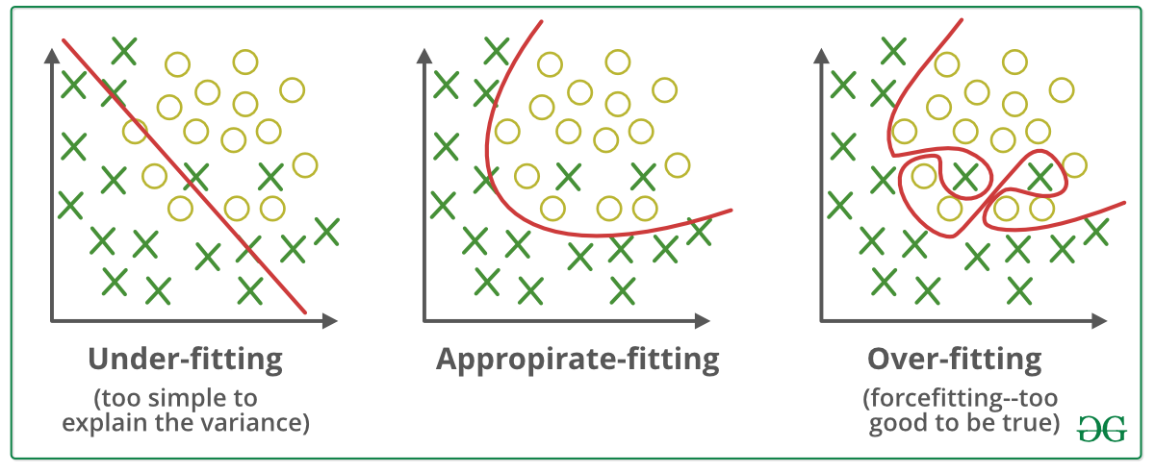
Overfitting and Underfitting

Slide 4
Dropout Technique for Regularization
A technique in which some of the randomly selected neurons are ignored during training.
In this case, other neurons have to handle the representation required for making predictions for the ignored neurons
Hence, networks become less sensitive to the specific weights of neurons and will result in a network capable of better generalization

Slide 5
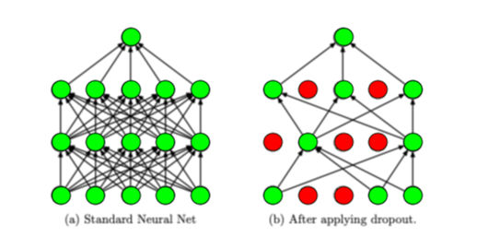
Dropout Technique for Regularization
In left image, there is an original neural network where all neurons are working.
In the right image, the neurons in red have been dropped out and will not be considered during the model training.

Slide 6
Why Dropout for overfitting?
The neurons do not rely on only single input since it might be dropped randomly. This also removes biases which is a major cause of overfitting
Learning of neurons will not be based upon redundant details of input and allows the network to get useful information which can then be used in making predictions.

Slide 7
Tips for using Dropout
Smaller dropout value of 20% to 50% is better
Its better to use dropout on hidden as well as visible layers
Using dropout with larger networks improves performance and provides better results
Limit the size of network weights
Use large momentum and large learning rate

